Slide 1



Project Presentation (KCS 753) Satellite Image Processing
KIET Group of Institutions, Ghaziabad
(An ISO – 9001: 2008 Certified & ‘A+’ Grade accredited Institution by NAAC)
Guide: Ms. Shivani and Dr. Sushil Kumar
Team Members:
Anubhav Yadav | 2000290120033 | CS-7A |
Ajay Varshney | 2000290120016 | CS-7A |
Aayush Sharma | 2000290120004 | CS-7A |
This Photo by Unknown Author is licensed under CC BY-SA

Slide 2
Problem Statement

Slide 3

Problem Statement
Develop an automated satellite image processing system capable of accurately identifying and monitoring changes in land use and land cover over time to support urban planning, environmental conservation, and disaster management.

Slide 4
Objectives

Slide 5
Objectives
Takes a satellite image of a particular area.
Highlights the roads detected in that area.
Highlights the buildings detected in that area.
Highlights the vegetation in that area
Creating land-use/landcover map of an area
And some similar operations like those

Slide 6
Technology

Slide 7
Technology Used
Resnet60
OpenCV
Web
VGG16
InceptionV3

Slide 8
Implementation

Slide 9
Project Status

Slide 10
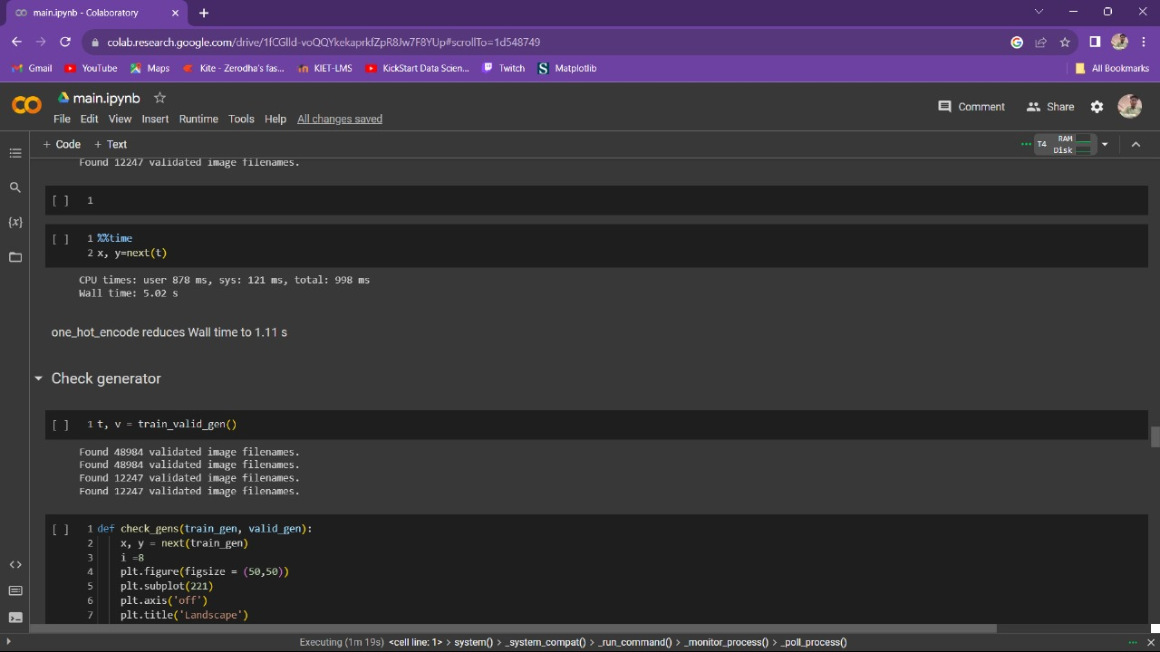

Slide 11
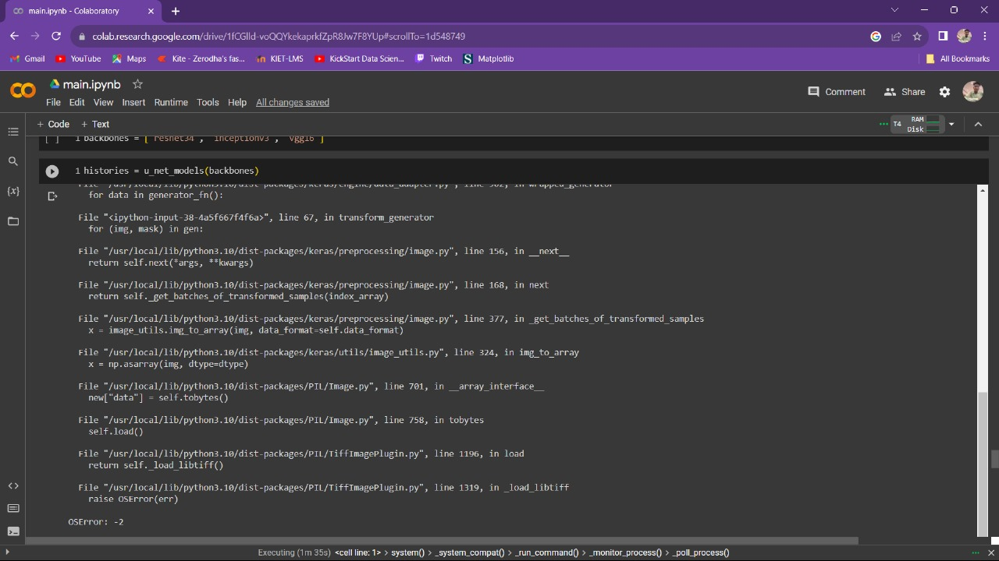

Slide 12
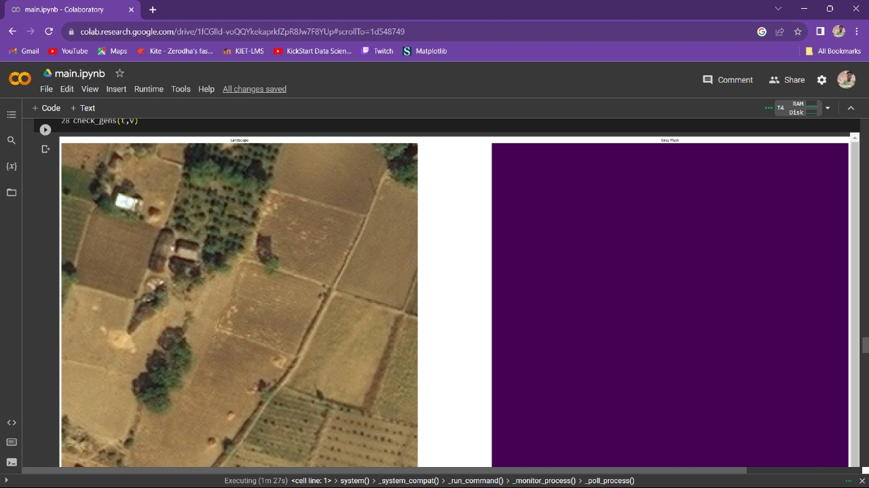

Slide 13
Literature Review

Slide 14
Literature Survey
A Review on Applications of Big Data for Disaster Management By Muhammad Arslan, Ana-Maria Roxin, Christophe Cruz, Dominique Ginhac
This passage describes the process of conducting a literature search on big data applications in disaster management, focusing on articles from 2007 to 2017 and utilizing various databases. It highlights the use of geoinformatics, remote sensing, social media, and technologies like Hadoop in disaster management. The passage also discusses the importance of data integration and web-based access to information for effective decision-making, along with specific applications such as Hadoop for data collection and 3D simulation scenarios for event venues. Overall, it underscores the role of big data and IoT in disaster management systems.

Slide 15
Literature Survey
A Review on Applications of Big Data for Disaster Management By Muhammad Arslan, Ana-Maria Roxin, Christophe Cruz, Dominique Ginhac
This paper reviews the use of big data in disaster management, highlighting its potential and the need for seamless integration of diverse data sources, data consistency, data preprocessing, data mining, and security and privacy considerations to enhance decision-making and reduce the impact of disasters.

Slide 16
Literature Survey
The Rising Role of Big Data Analytics and IoT in Disaster Management: Recent Advances, Taxonomy and Prospects By Syed Attique Shah, Dursun Zafer Seker, Sufian Hameed, Dirk Draheim
Big data analytics is instrumental in disaster management, leveraging various technologies and tools to analyze diverse data sources, including social media and sensors, for improved decision-making, situational awareness, and risk assessment, as demonstrated by recent studies.

Slide 17
Literature Survey
Image segmentation and classification of large scale satellite imagery for land use: A review of the state of the arts By A. A. Adegun, N.O. Akande, R. O. Ogundokun and E.O. Asani
This paper conducts a comprehensive survey of cutting-edge algorithms for large-scale satellite image segmentation and land use classification, emphasizing the growing role of machine learning, particularly deep learning, in leveraging vast datasets for improved accuracy, and demonstrating the superior performance of deep learning methods in comparison to existing algorithms.

Slide 18
Literature Survey
The three ghosts of medical AI: Can the black-box present deliver? By Thomas P. Quinn, Simon Coghlan , Vuong Le(2021)
Modern machine learning, while holding promise for healthcare transformation, faces challenges of transparency and trust in clinical decision-making, emphasizing the need for interpretable AI models to align with medical standards.

Slide 19
Literature Survey
AI as a friend or assistant: The meditating role of perceived usefulness in social AI verses functional AI By Jihyun Kim, Kelly Merrill, Chad Collins(2021)
Perceptions of AI are influenced by its functional versus social roles, with functional AI generally garnering more positive attitudes and realistic expectations, highlighting the evolving dynamics of human-AI interactions and the importance of communication orientation in the digital realm.

Slide 20
Workflow Diagram

Slide 21
Data Flow Diagram

Slide 22
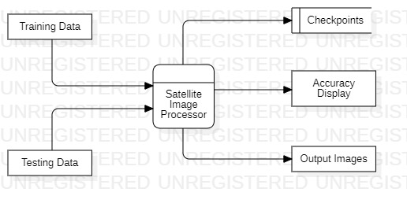
Level 0

Slide 23
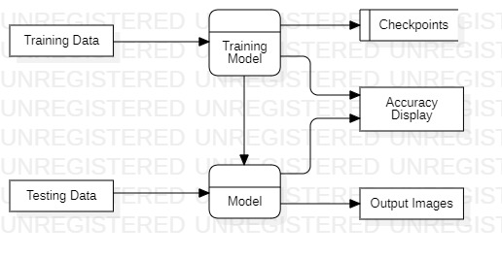
Level 1

Slide 24
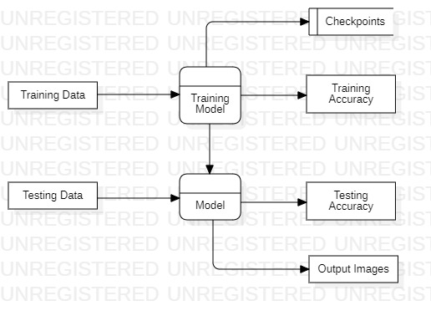
Level 2

Slide 25
Entity-Relationship Diagram

Slide 26
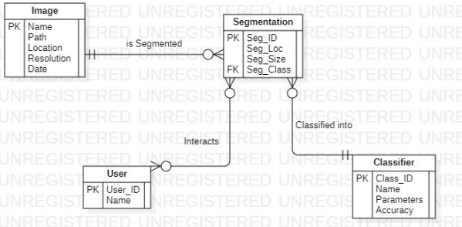

Slide 27
Patent Status

Slide 28
Patent Status:
Filing Date : 10/03/2024
Given
Submitted
Filed & Application Number issued (202411017148)
Published

Slide 29
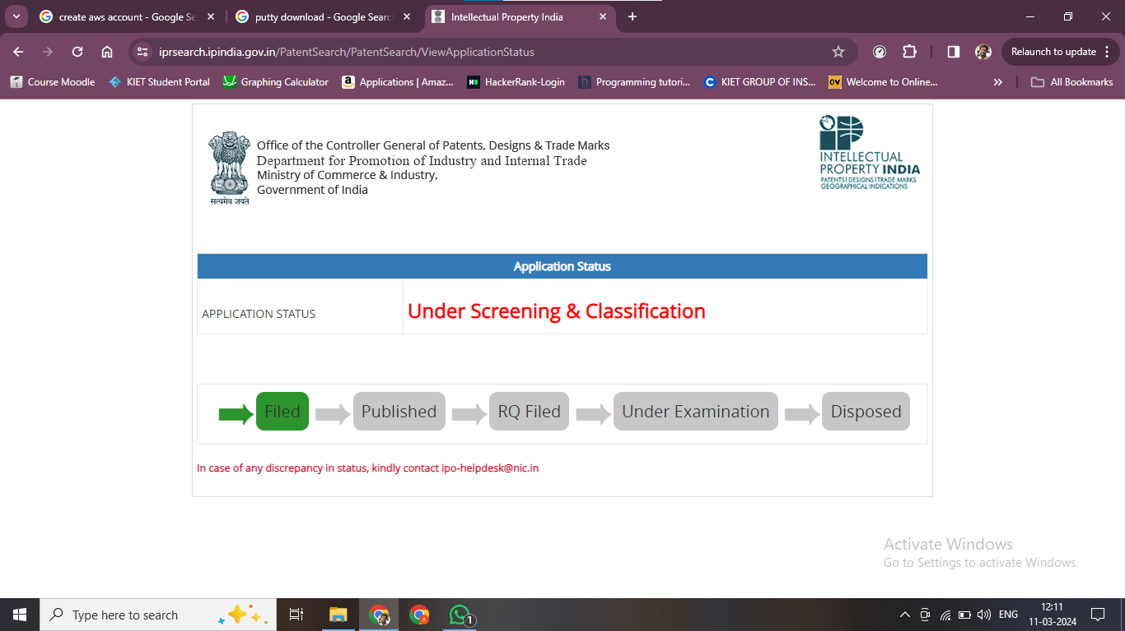

Slide 30
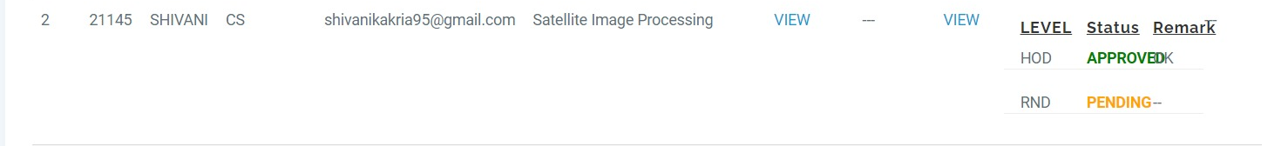

Slide 31


Slide 32
Research Paper Status

Slide 33
Research Paper Status:
Given
Submitted
Accepted
Presentation (14/03/2024)
Published

Slide 34
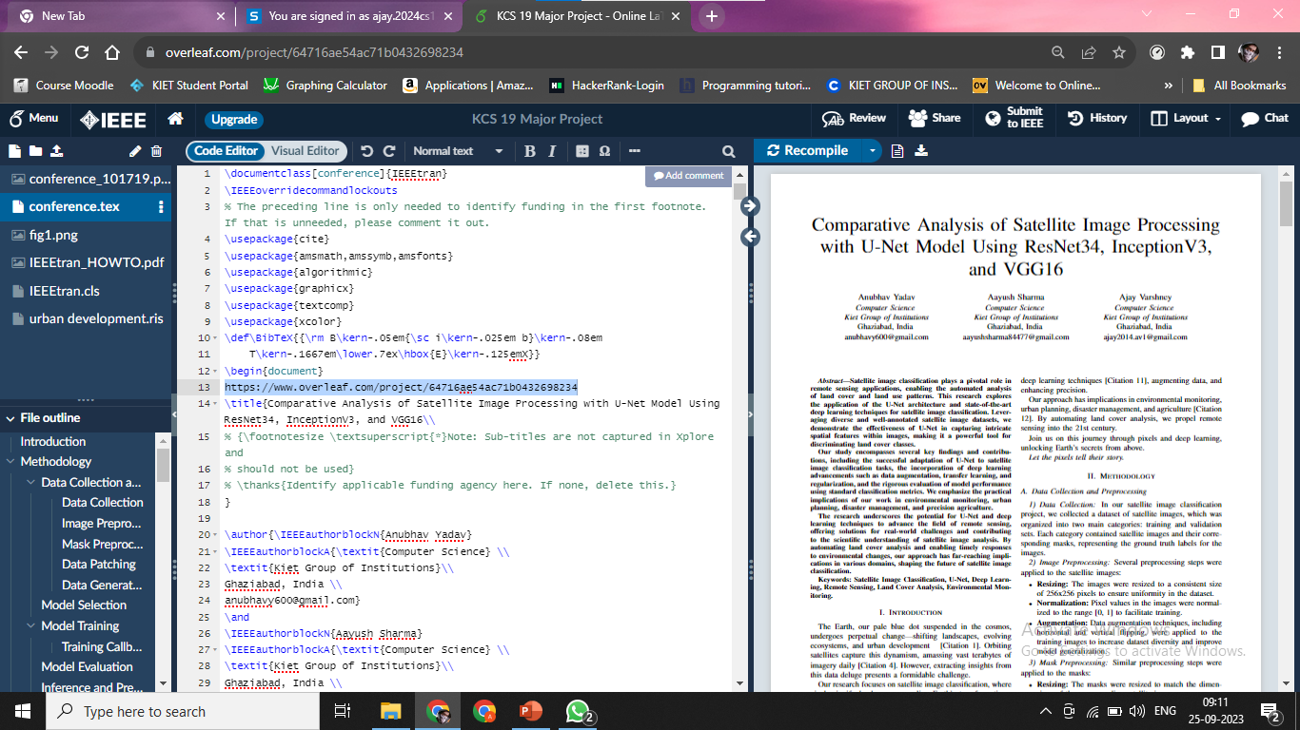

Slide 35


Slide 36
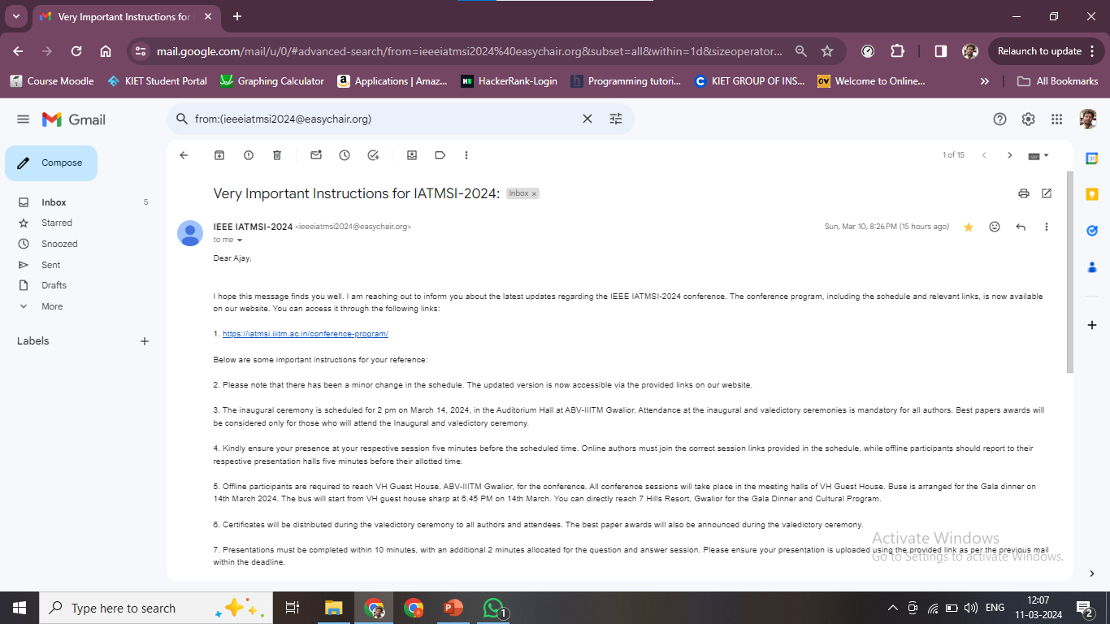

Slide 37
References

Slide 39
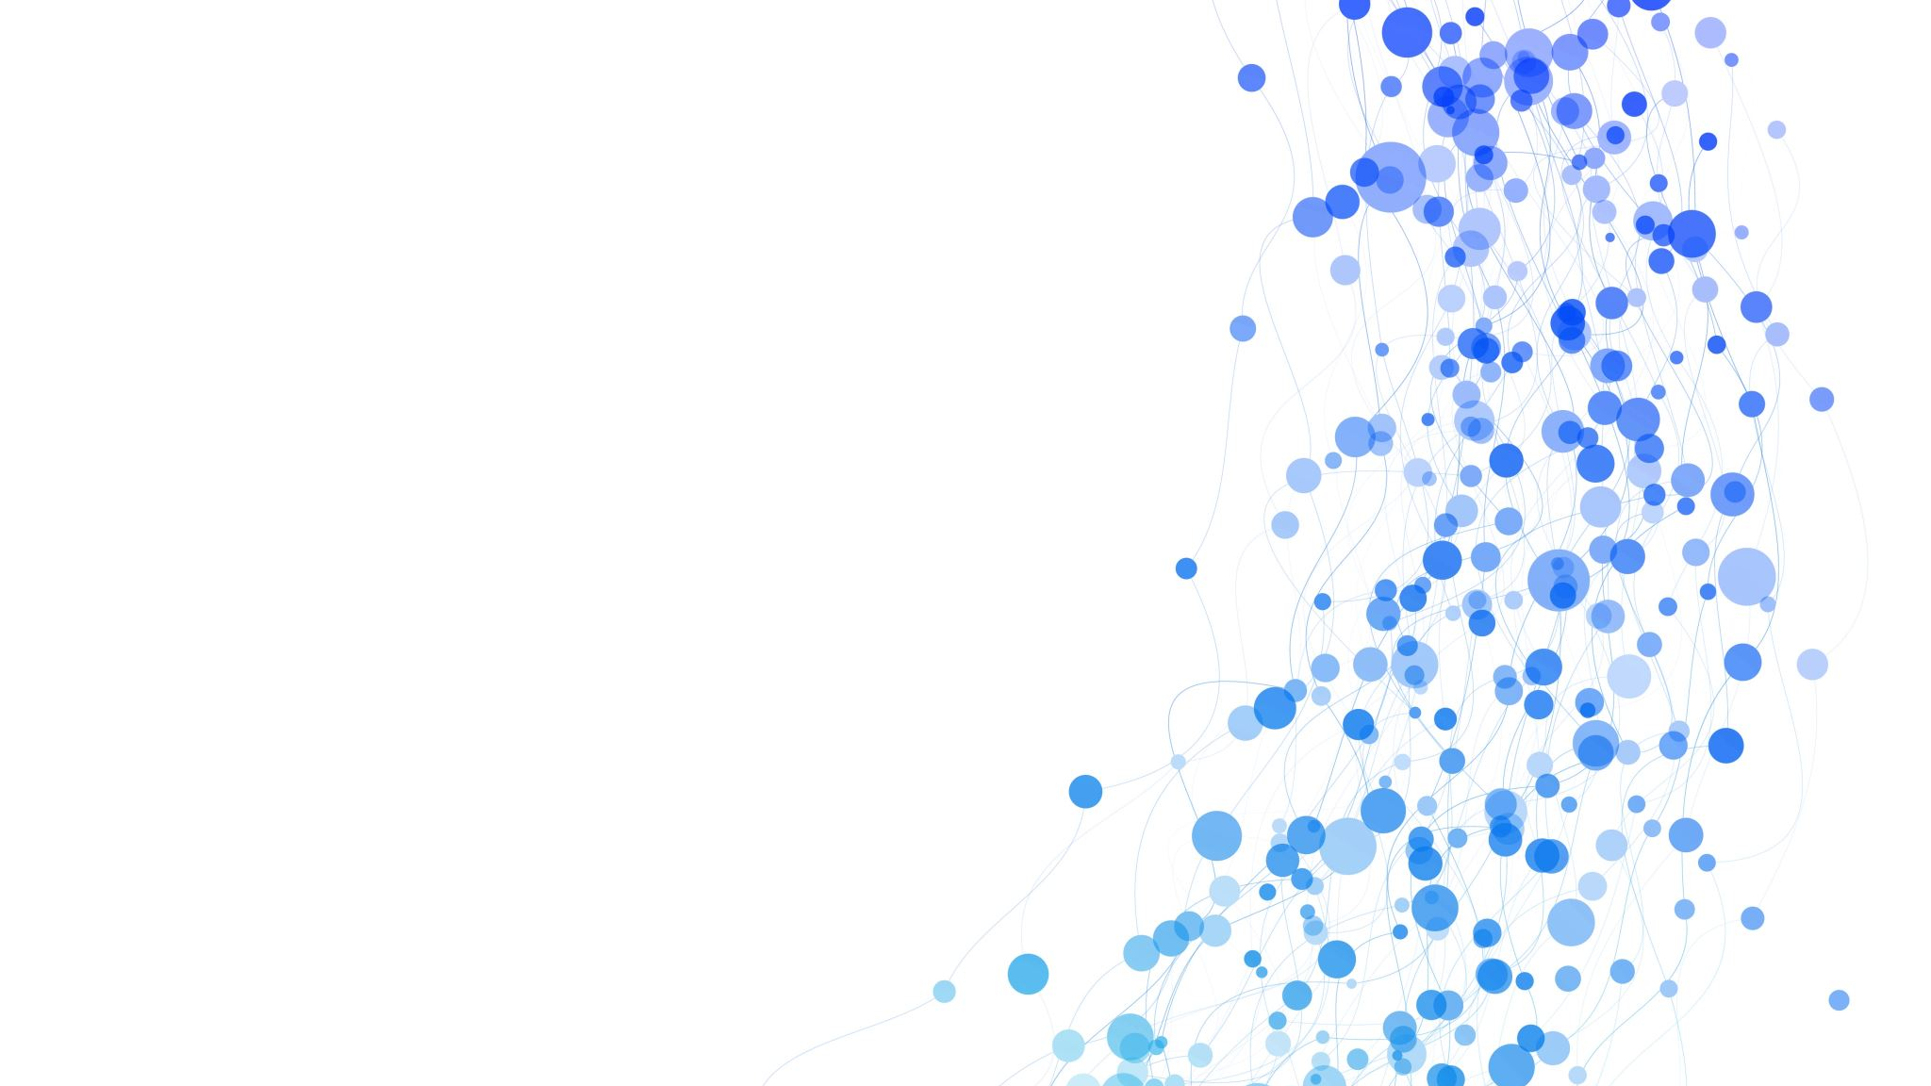
Thank You

